Slide 1
CIS 20 CRITICAL SECURITY CONTROLS
What are the CIS 20 Critical Security Controls ?

Slide 2
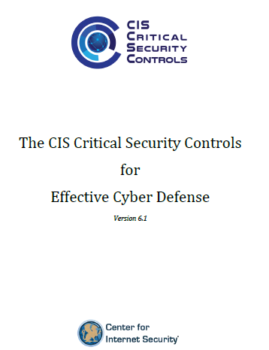
CIS 20 CRITICAL SECURITY CONTROLS
https://www.cisecurity.org/controls/

Slide 3
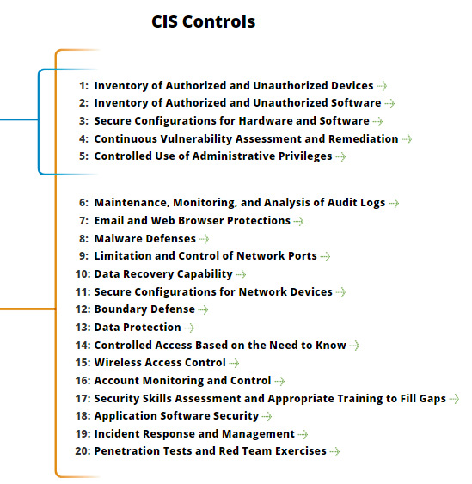
CIS 20 CRITICAL SECURITY CONTROLS
https://www.cisecurity.org/controls/

Slide 4
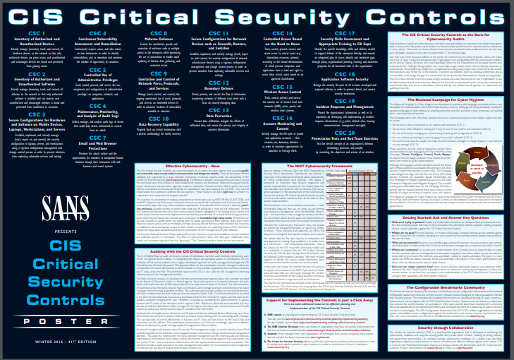
CIS 20 CRITICAL SECURITY CONTROLS
https://www.cisecurity.org/wp-content/uploads/2017/03/Poster_Winter2016_CSCs.pdf

Slide 5
CIS 20 CRITICAL SECURITY CONTROLS
CSC 1: Inventory of Authorized and Unauthorized Devices
CSC 2: Inventory of Authorized and Unauthorized Software
CSC 3: Secure Configurations for Hardware and Software on Mobile Devices, Laptops, Workstations, and Servers

Slide 6
CIS 20 CRITICAL SECURITY CONTROLS
CSC 4: Continuous Vulnerability Assessment and Remediation
CSC 5: Controlled Use of Administrative Privileges
CSC 6: Maintenance, Monitoring, and Analysis of Audit Logs

Slide 7
CIS 20 CRITICAL SECURITY CONTROLS
CSC 8: Malware Defenses
CSC 9: Limitation and Control of Network Ports, Protocols, and Services
CSC 10: Data Recovery Capability

Slide 8
CIS 20 CRITICAL SECURITY CONTROLS
CSC 11: Secure Configurations for Network Devices such as Firewalls, Routers, and Switches
CSC 12: Boundary Defense
CSC 13: Data Protection

Slide 9
CIS 20 CRITICAL SECURITY CONTROLS
CSC 14: Controlled Access Based on the Need to Know
CSC 15: Wireless Access Control
CSC 16: Account Monitoring and Control

Slide 10
CIS 20 CRITICAL SECURITY CONTROLS
CSC 17: Security Skills Assessment and Appropriate Training to Fill Gaps
CSC 18: Application Software Security
CSC 19: Incident Response and Management

Slide 11
CIS 20 CRITICAL SECURITY CONTROLS
CSC 20: Penetration Tests and Red Team Exercises
END

